Slide 1
Sparse matrix multiplication optimization:
an architectural perspective
杨沛山、张天杰
周炜、陈苇远
秦雨扬、刘晋玮
Notes:
我们小组的展示主题是
《稀疏矩阵乘法优化：从体系结构的视角》，接下来我们会介绍3篇有关的ASPLOS中选取的论文
Our group's presentation topic is "Optimization of sparse matrix multiplication: an architectural perspective",
sparse matrix multiplication optimization is a kind of operation which is optimized according to the characteristics of sparse matrix through special algorithm and storage mode, so as to improve the computation efficiency and reduce the storage space and we will then present three relevant papers selected from ASPLOS.

Slide 2
01
Background:Transformer and Deep learning
目录
DOTA:Detect and Omit Weak Attentions for Scalable Transformer Acceleration
02
CONTENTS
Spada: Accelerating Sparse Matrix Multiplication with Adaptive Dataflow
03
EVStore: Storage and Caching Capabilities for Scaling Embedded Tables in Deep Recommendation Systems
04

Slide 3

w
o
w
Intro & background

Slide 4


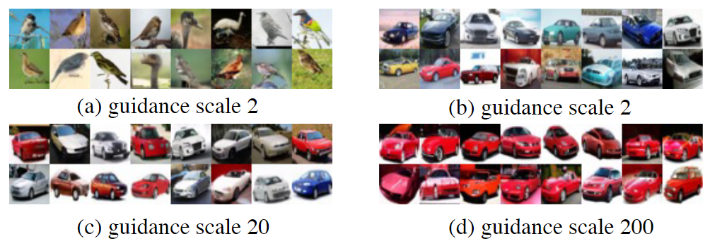

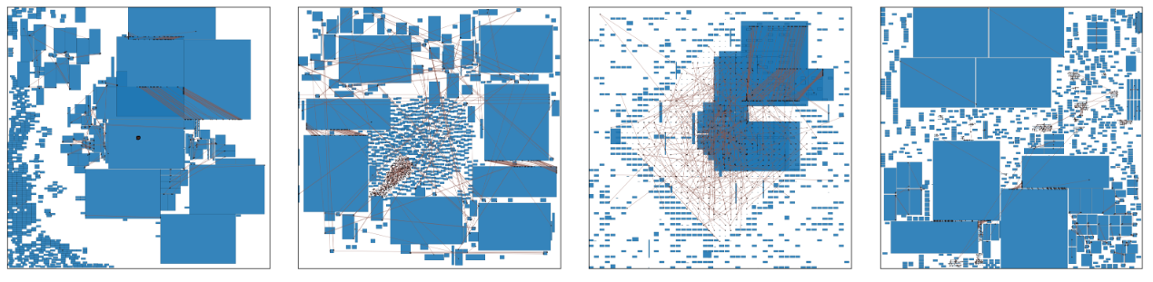
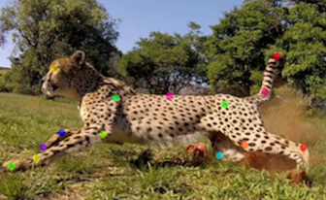
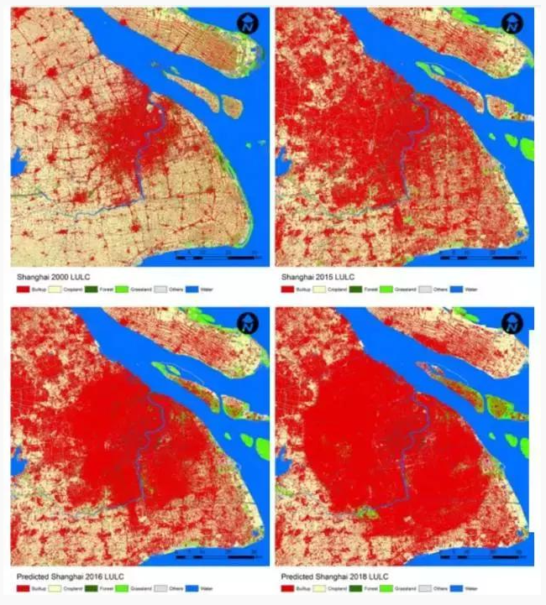
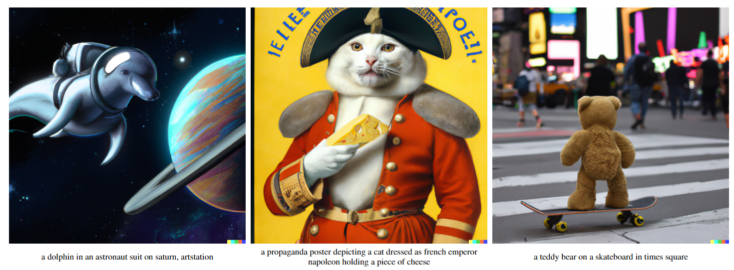

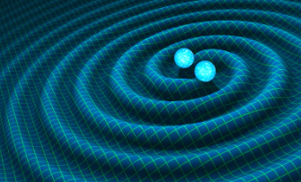
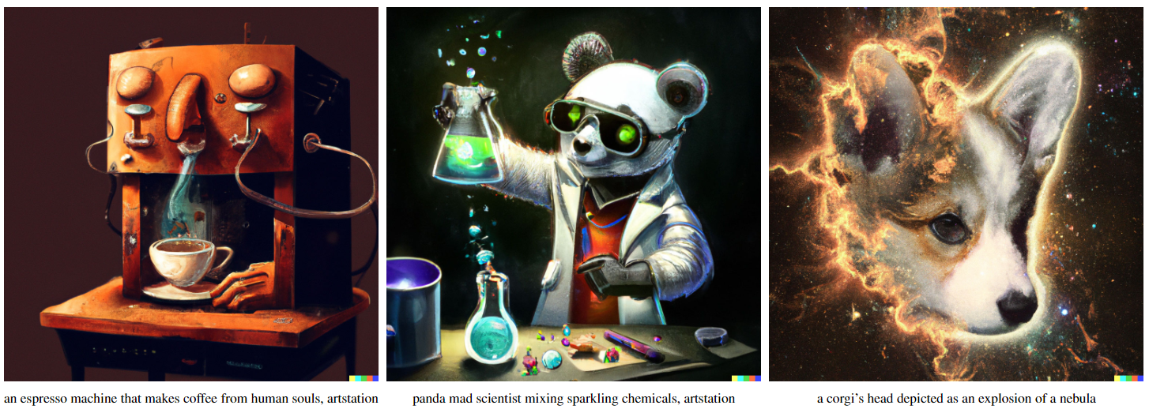
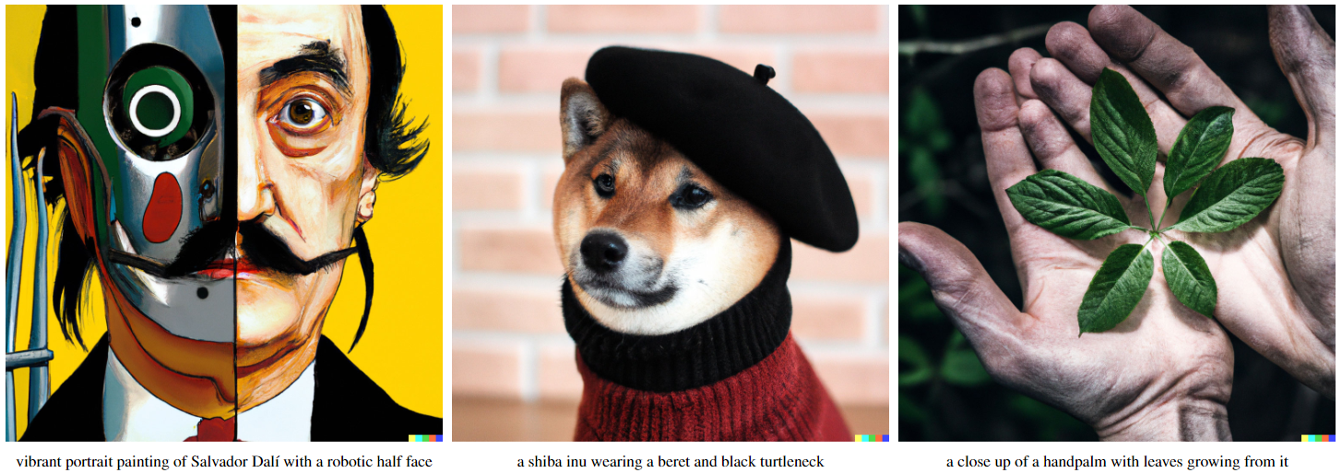
Deep learning
Classification
Chip Design
Estimation
Simulation 4 Science
Image Generation
Segment
Social Calculation
Notes:
Deep learning is tremensely popular right now, and it involves a lot of matrix operations, which is time-taking and laborious. The main optimization direction of mainstream frameworks such as pytorch and tensorflow is also matrix operation acceleration.

Slide 5
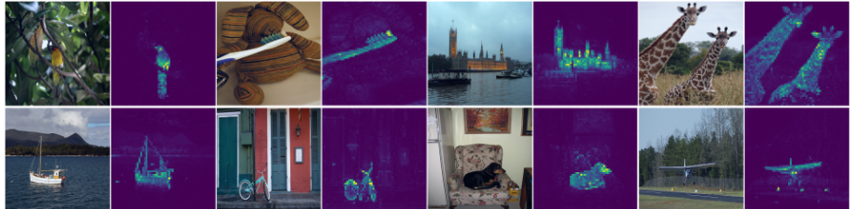
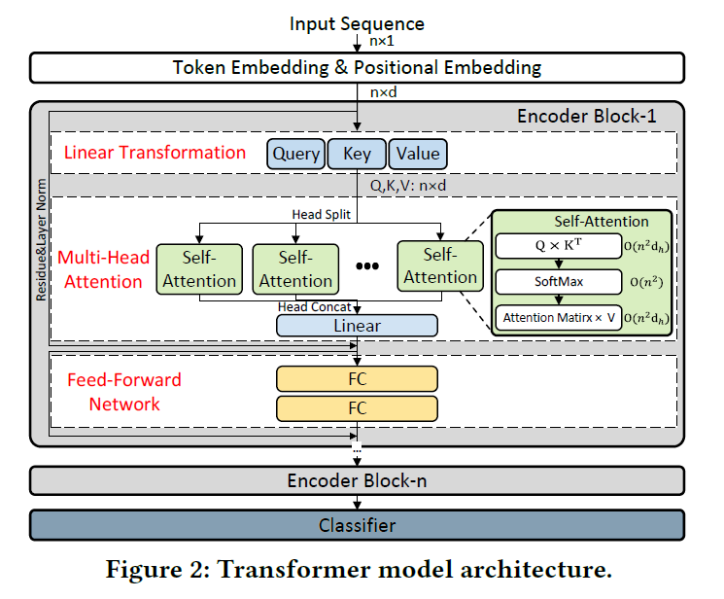
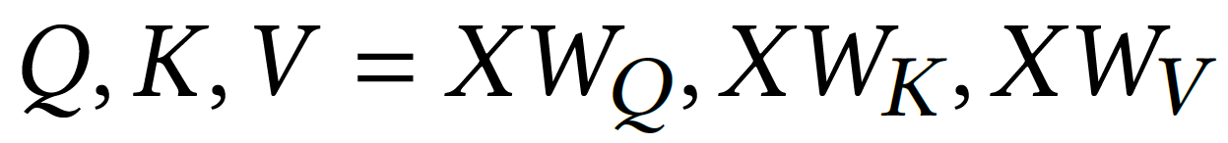
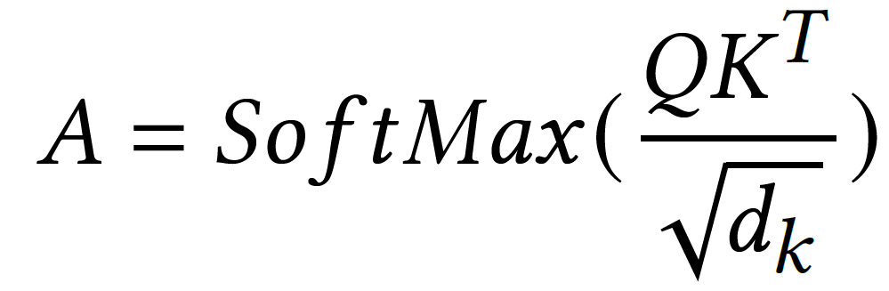

Dense matrix multiplication
Main matrix multiplication calculations
in Encorder
Notes:
A large number of these matrix operations are operations on coefficient matrices, taking the awesome transformer as an example.
there are three main matrix multiplications

Slide 6
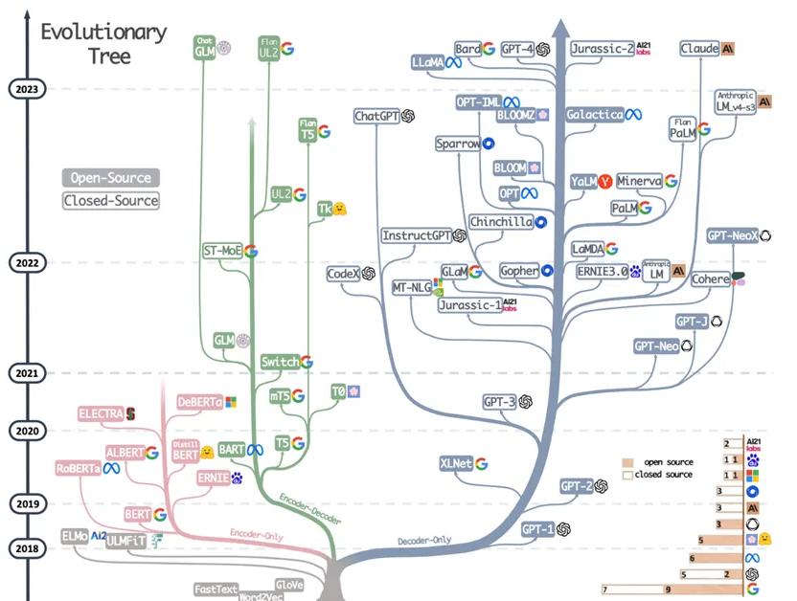
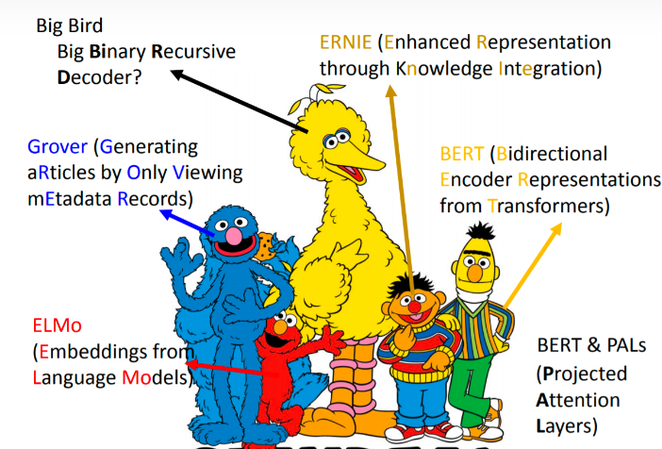
LLMs (large language models )
Notes:
The popular and prospective large language models like gpt , bert, llama etc, that have become so popular in recent years can simply be viewed as a stack of transformer

Slide 7
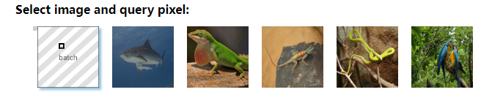
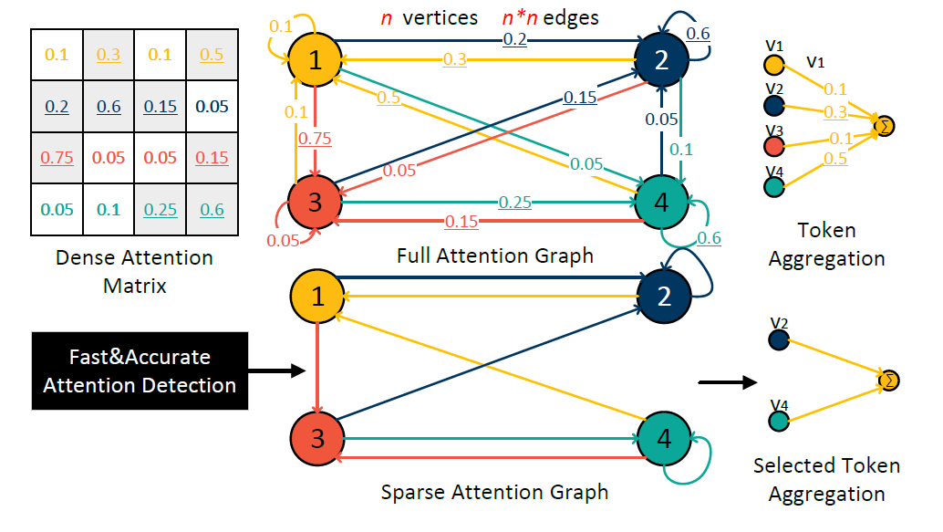
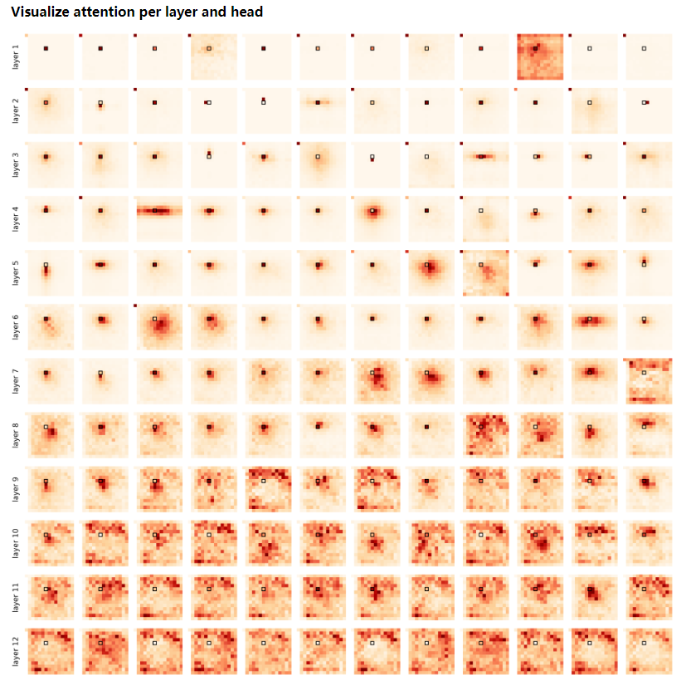
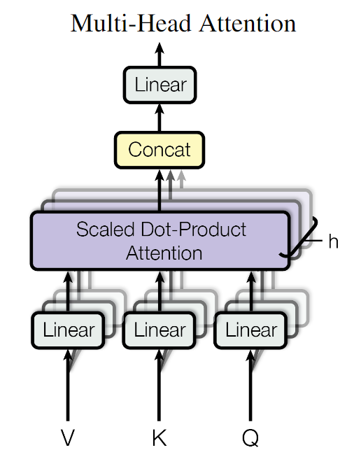
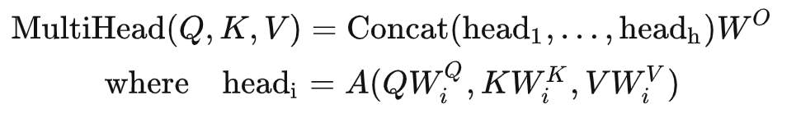
The graph perspective of self-attention
Multi-head
Notes:
Despite the impressive performance, long-sequence Transformer processing is expensive due to sparse computation complexity and memory consumption of self-attention.

Slide 8

PART.02
DOTA:Detect and Omit Weak Attentions for Scalable Transformer Acceleration
Zheng Qu, Liu Liu, Fengbin Tu, Zhaodong Chen,
Yufei Ding, Yuan Xie
UC Santa Barbara
Notes:
To alleviate this problem, we first present DOTA, an algorithm-architecture co-design that effectively addresses the challenges of scalable Transformer inference

Slide 9
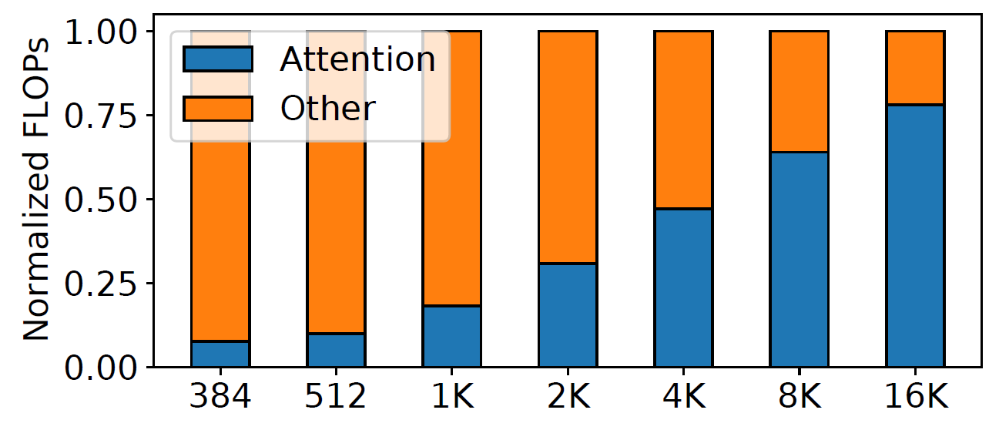
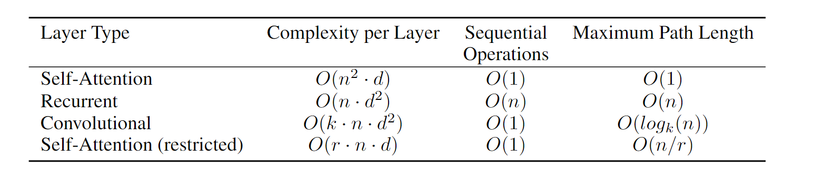
Computational Complexity
Breakdown of attention operations vs. other operations
when scaling sequence length
per-layer complexity and minimum number of
sequential operations for different layer types
Notes:
Since the complexity of the attention mechanism increases with the number of tokens (both the length of the sequence) in a square number
The computation of the attention mechanism then becomes the main challenge in the computation of the Transformer model.

Slide 10
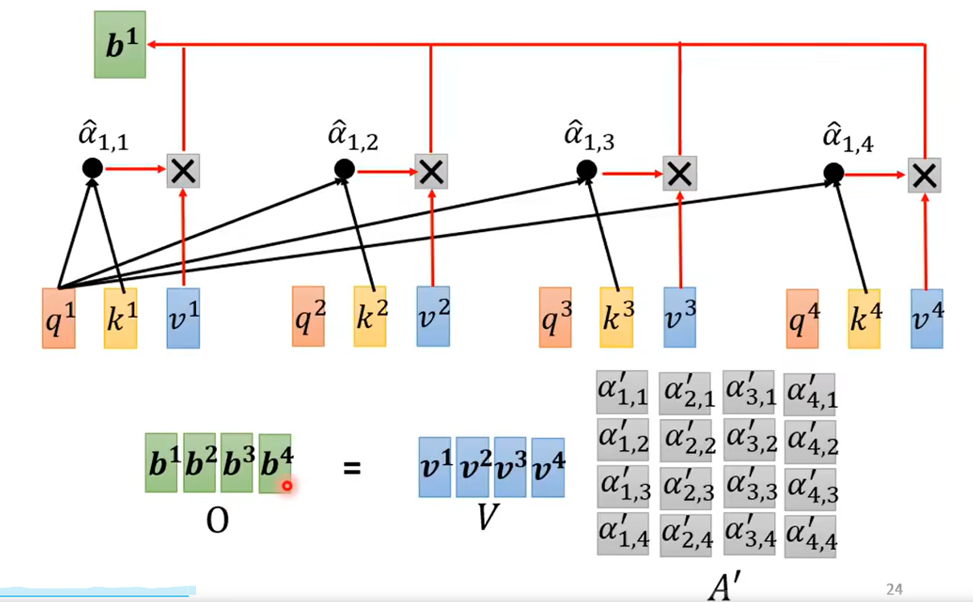
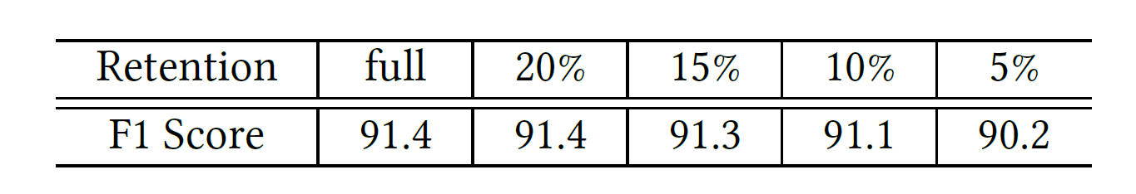
Not all attention is needed
Transformer evaluation accuracy results, i.e., SQuAD F1 scores, when omitting different portion of attentions
Notes:
The root cause of the quadratic complexity in self-attention is the fully-connected attention graph. So, the author trys to random drop some connection, and find that the performance drop little

Slide 11
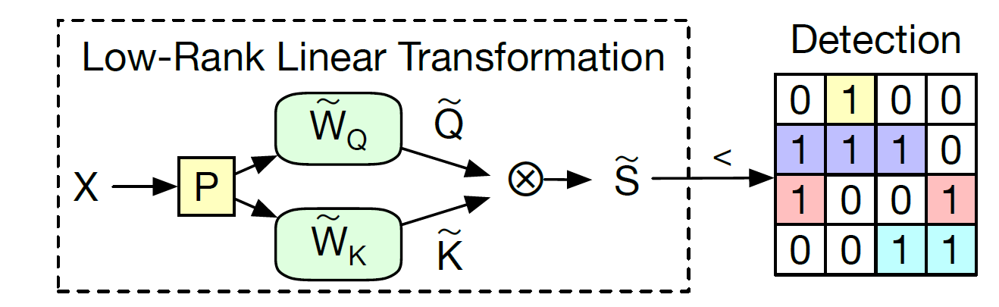
Weak Attentions Detection
(1) The input X will first be linearly converted into a low-dimensional
is reduce the dimensions of X from n*d to n*k (where k is much smaller than d)
Weak attention detection from estimated attention scores computed by low-rank linear transformations.
weight matrix
Notes:
Based on the fact that not all attentions are important, the authors trained a simple Weak Attention Detector in parallel with the training of the Transformer model. When reasoning, this detector predicts weak correlations between tokens before computing the attention weight matrix, and ignores these tokens when computing attention

Slide 12
Weak Attentions Detection
(2) Multiply the image by and , to get an estimated attention score of size n x n
Weak attention detection from estimated attention scores computed by low-rank linear transformations.
We can use the to predict the weak attention position in the A matrix, and skip* the corresponding calculations when calculating the A matrix.
* The threshold of weak attention can be searched through a top-K algorithm

Slide 13
DOTA SYSTEM DESIGN
Overall System
Architecture
Reconfigurable Matrix
Multiplication Unit
Token-Parallel Dataflow for Sparse Attention Computation
Abstraction of the model
Large GEMM/GEMV computations with configurable hidden dimensions
Disassemble the algorithm and identify the essential components
A reconfigurable design dynamically balance the computation throughput of multi-precision computations
support low-precision computations required by the attention detection
Token-Parallel Dataflow
Workload Balancing
Out-of-Order Execution
workload imbalance and irregular memory access caused by attention sparsity

Slide 14
DOTA SYSTEM DESIGN
Overall System
Architecture
Reconfigurable Matrix
Multiplication Unit
Token-Parallel Dataflow for Sparse Attention Computation
Abstraction of the model
Large GEMM/GEMV computations with configurable hidden dimensions
Disassemble the algorithm and identify the essential components
A reconfigurable design dynamically balance the computation throughput of multi-precision computations
support low-precision computations required by the attention detection
Token-Parallel Dataflow
Workload Balancing
Out-of-Order Execution
workload imbalance and irregular memory access caused by attention sparsity

Slide 15
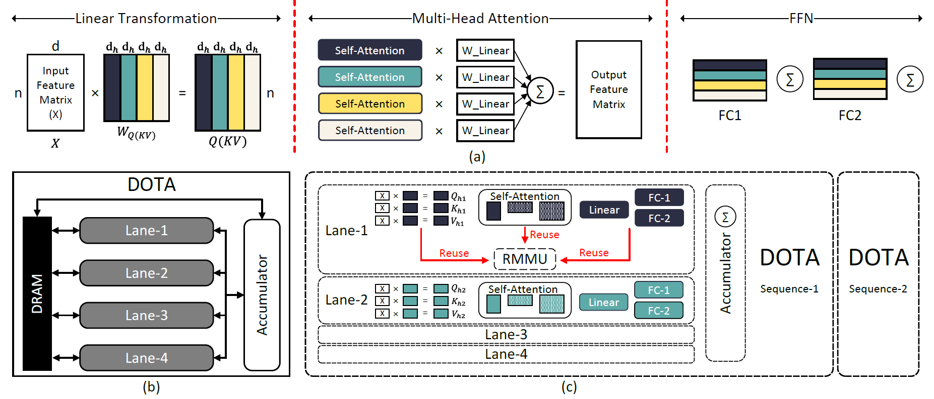
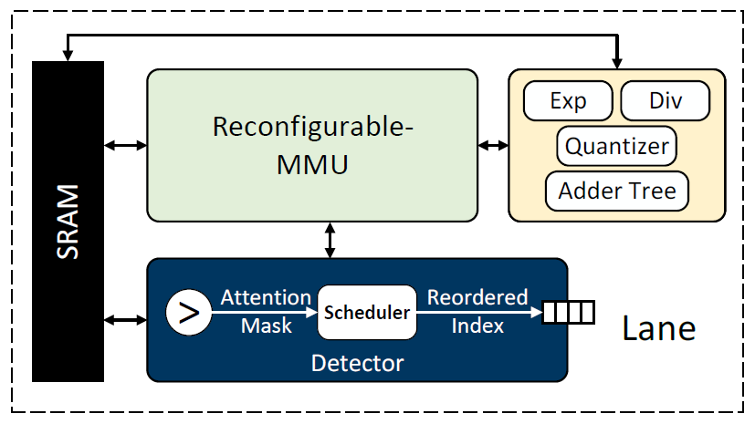
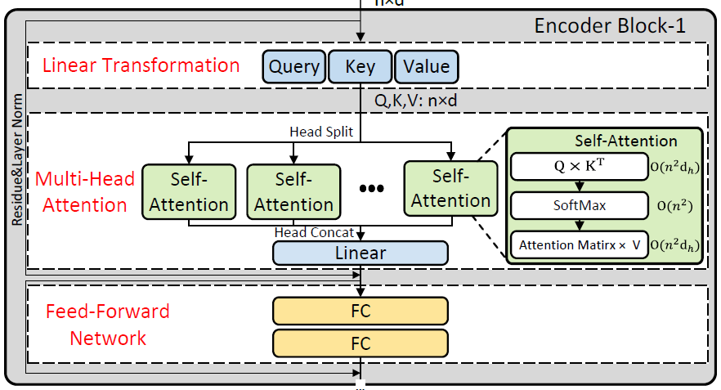
Overall System Architecture
Notes:
DOTA system design. (a) The abstraction of a single encoder block. We divide each encoder into three sequential
stages. Each stage contains multiple GEMM operations that can be further cut into chunks (represented by different colors)
and mapped to different compute Lanes. (b) Overall system design of DOTA. Each compute Lane communicates with off-chip
DRAM for input feature. The intermediate results are summed up in the Accumulator. (c) Computation mapping between the
algorithm and hardware. Each DOTA accelerator processes one input sequence, and each Lane computes for one chunk (color).

Slide 16
DOTA SYSTEM DESIGN
Overall System
Architecture
Reconfigurable Matrix
Multiplication Unit
Token-Parallel Dataflow for Sparse Attention Computation
Abstraction of the model
Large GEMM/GEMV computations with configurable hidden dimensions
Disassemble the algorithm and identify the essential components
A reconfigurable design dynamically balance the computation throughput of multi-precision computations
support low-precision computations required by the attention detection
Token-Parallel Dataflow
Workload Balancing
Out-of-Order Execution
workload imbalance and irregular memory access caused by attention sparsity

Slide 17
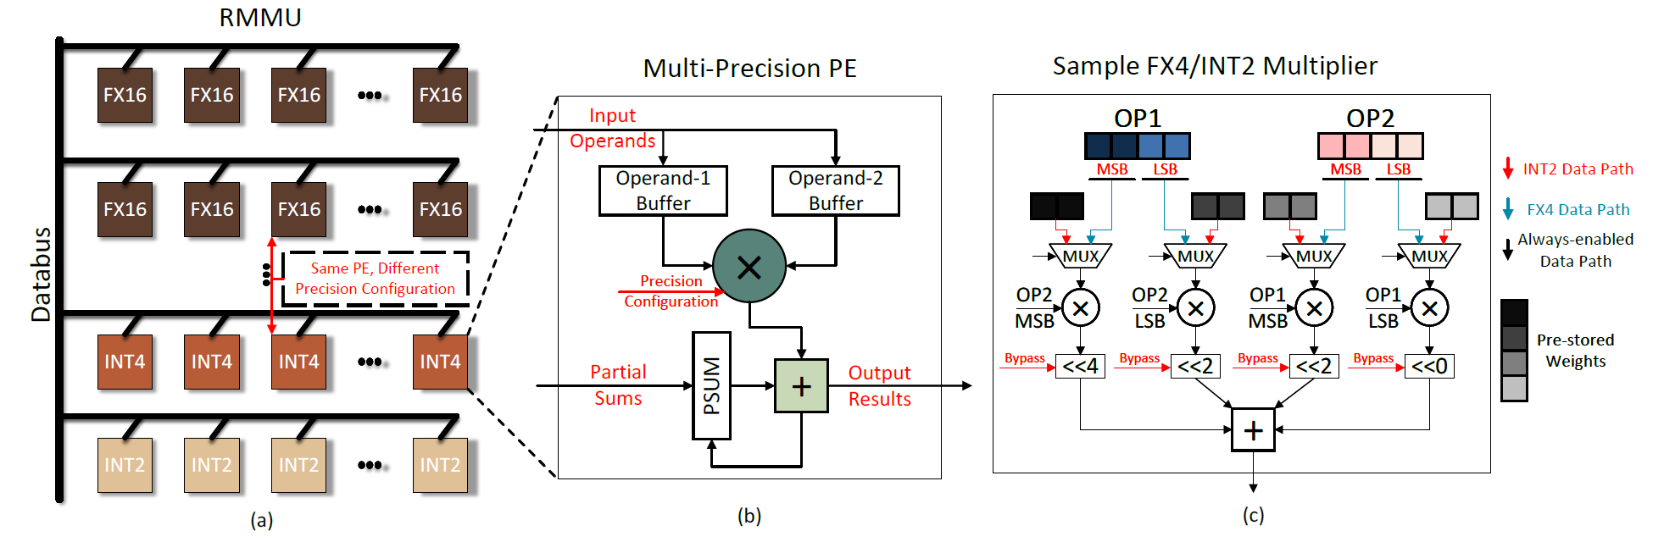
Reconfigurable Matrix Multiplication Unit
Figure 7: Design of the Reconfigurable Matrix Multiplication Unit. (a) RMMU is composed of a 2D PE array, where each row can be configured to a specific computation precision. (b) Each PE is a multi-precision MAC unit. (c) A sample FX4/IN2 multi-precision multiplier. The key is to build up high precision multiplication data path with low precision multipliers. In low precision mode, we split and multiply the input operands with pre-stored weights and perform in-multiplier accumulation. Therefore, the computation throughput is quadratically improved while input/output bit-width are kept the same as high precision mode.
Notes:
DOTA system design. (a) The abstraction of a single encoder block. We divide each encoder into three sequential
stages. Each stage contains multiple GEMM operations that can be further cut into chunks (represented by different colors)
and mapped to different compute Lanes. (b) Overall system design of DOTA. Each compute Lane communicates with off-chip
DRAM for input feature. The intermediate results are summed up in the Accumulator. (c) Computation mapping between the
algorithm and hardware. Each DOTA accelerator processes one input sequence, and each Lane computes for one chunk (color).

Slide 18
DOTA SYSTEM DESIGN
Overall System
Architecture
Reconfigurable Matrix
Multiplication Unit
Token-Parallel Dataflow for Sparse Attention Computation
Abstraction of the model
Large GEMM/GEMV computations with configurable hidden dimensions
Disassemble the algorithm and identify the essential components
A reconfigurable design dynamically balance the computation throughput of multi-precision computations
support low-precision computations required by the attention detection
Token-Parallel Dataflow
Workload Balancing
Out-of-Order Execution
workload imbalance and irregular memory access caused by attention sparsity

Slide 19
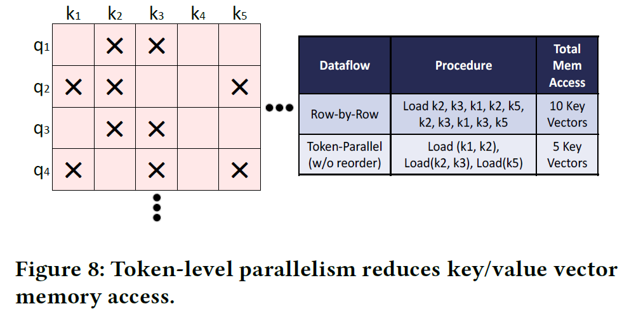
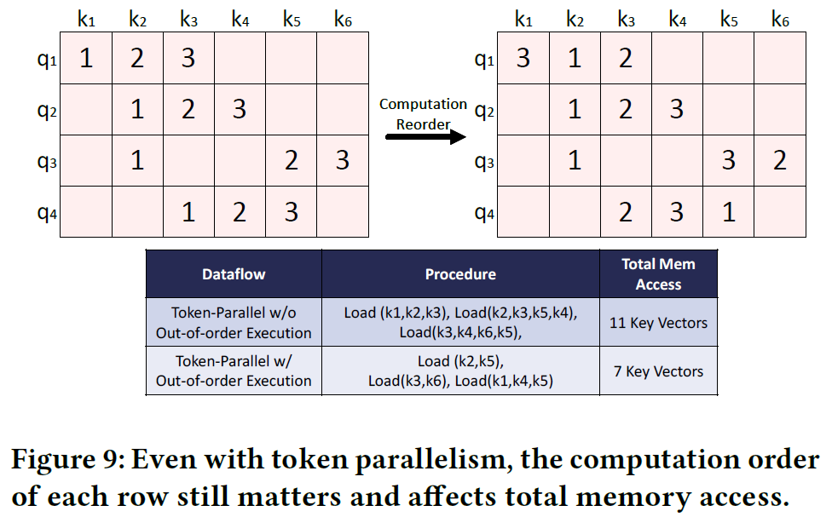
Token-Parallel Dataflow for Sparse
Attention Computation
Token-Parallel Dataflow
Workload Balancing
Out-of-Order Execution

Slide 20
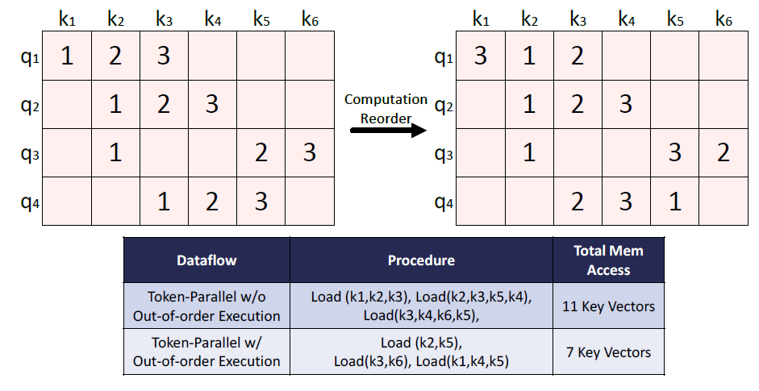
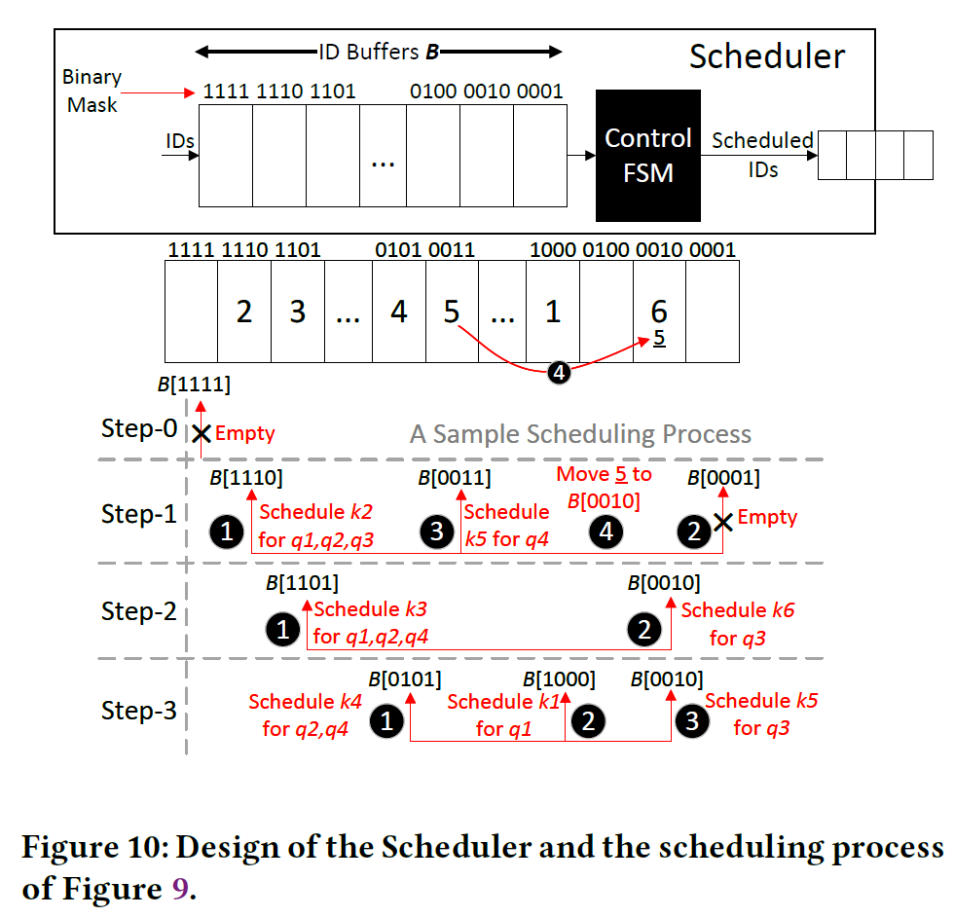
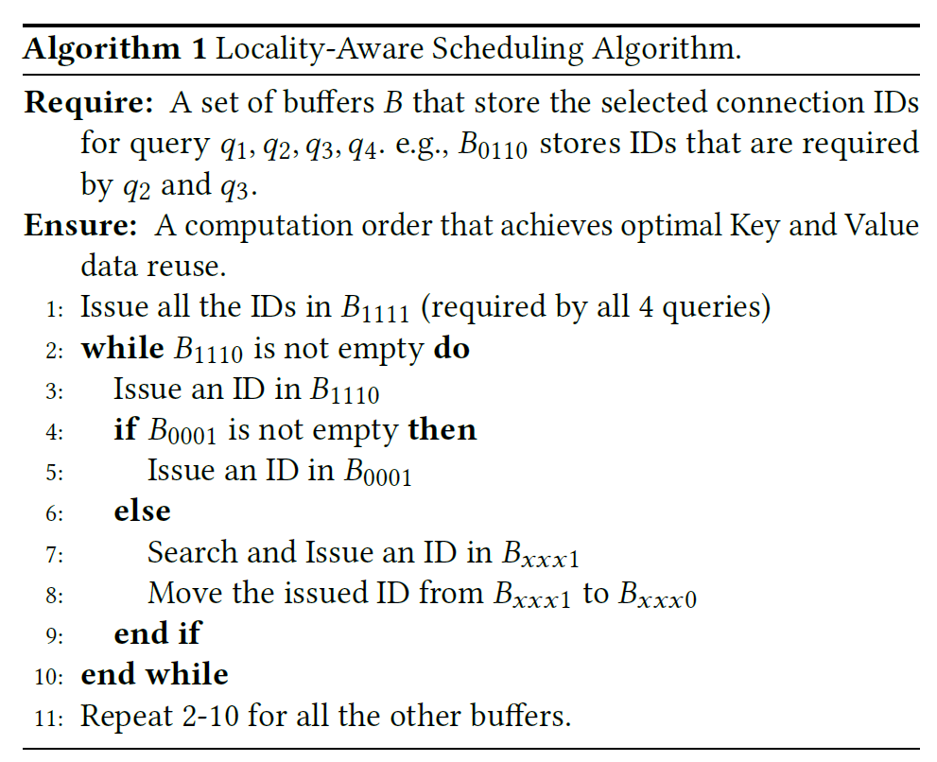
Scheduler

Slide 21
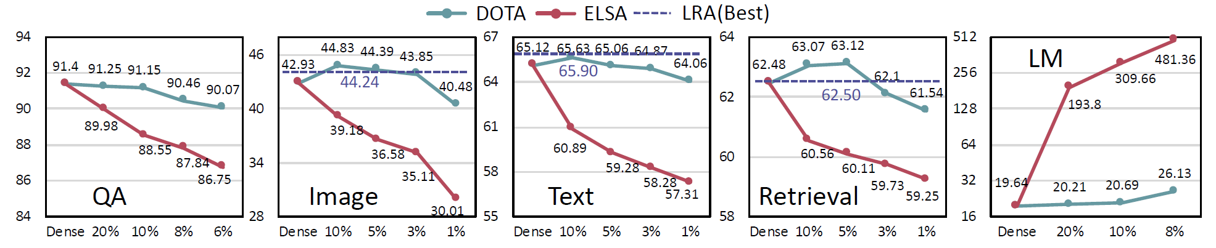
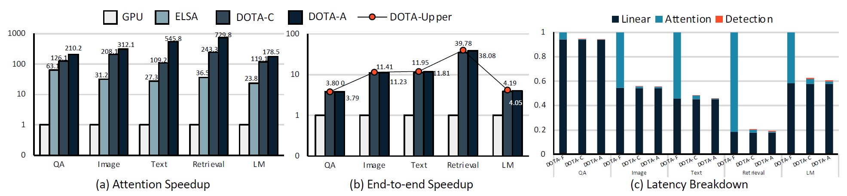
Performance：Model accuracy & Speedup
Notes:
Figure 11: Model accuracy of DOTA comparing with dense baseline and ELSA under different retention ratios across the
benchmarks. The performance metric of GPT-2 is perplexity score, the lower the better. The other dataset uses accuracy, the
higher the better. The purple line indicates the best results provided by the LRA benchmark
Figure 12: (a) Speedup of DOTA over GPU and ELSA on attention block. (b) End-to-end speedup over GPU. Red dots indicate the
theoretical performance upper-bound of an accelerator. (c) Normalized latency breakdown of DOTA. DOTA-F means to compute
the Full attention graph with DOTA without detection and omission. DOTA-C (Conservative) and DOTA-A (Aggressive) both
adopt attention detection, while DOTA-C allows for an accuracy degradation less than 0.5% and DOTA-A allows for 1.5%.

Slide 22
Summary
System-level support for end-to-end large Transformer model inference
detects and omits weak connections
skip the corresponding computations and memory accesses
Algorithm-architecture co-design
The proposed algorithm and system design works well.

Slide 23

PART.03
Spada: Accelerating Sparse Matrix
Multiplication with Adaptive Dataflow
Zhiyao Li, Jiaxiang Li, Taijie Chen, Dimin Niu,
Hongzhong Zheng, Yuan Xie, Mingyu Gao
Tsinghua University, Northwestern University,
Alibaba DAMO Academy, Shanghai Qi Zhi Institute
Notes:
Hello everyone, I’m yps/ztj. We are going to introduce the paper Spada: accelerating sparse matrix multiplication with adaptive dataflow

Slide 24
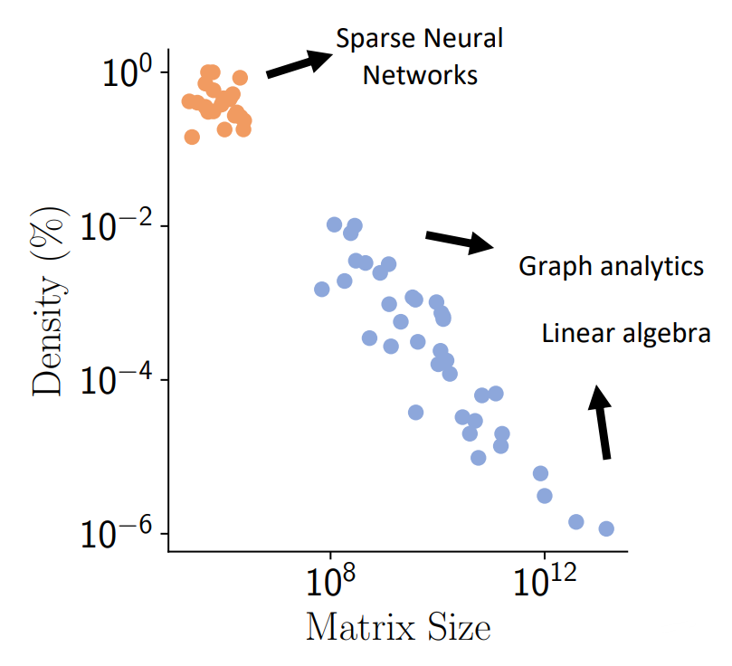
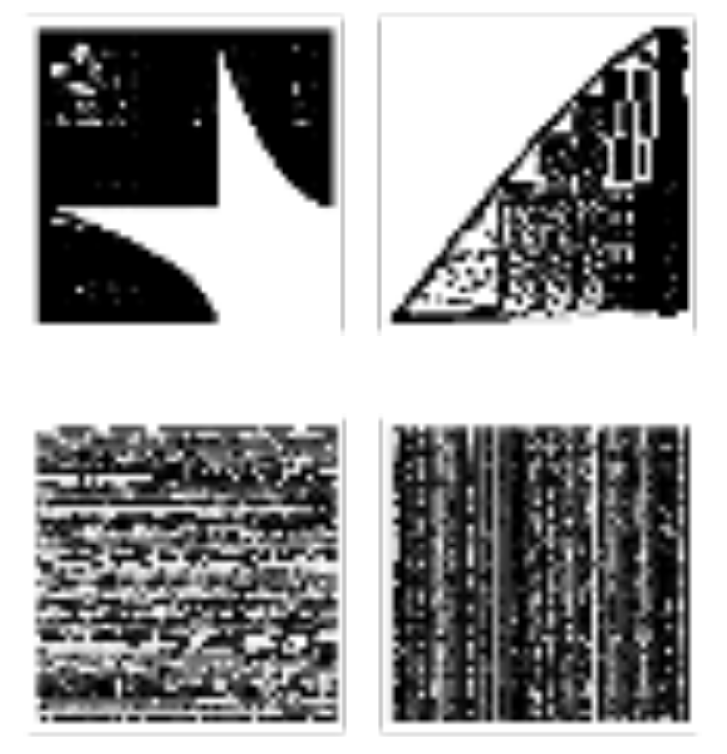
SpGEMM and sparse patterns
Wide applications
Varying size & density
Diverse nonzero distribution
Graph analytics
Linear algebra
Molecule dynamics
Economic modeling
Sparse Neural Networks
Diverse sparse patterns
Intersection efficiency
Partial sum generation
Data reuse
Notes:
Sparse matrices multiplication, or SpGEMM, is widely used from graph analytics, molecule dynamics to machine learning.
However, these matrices have varied size and density. For example, the densities of sparse neural networks is much larger than the density of graph analytics. Besides, the non-zero distributions of these matrices are also very diverse. These together creates diverse sparse patterns across different workloads. This sparse patterns result in SpGEMM being executed with different intersection efficiency, partial sum generation and data reuse.

Slide 25
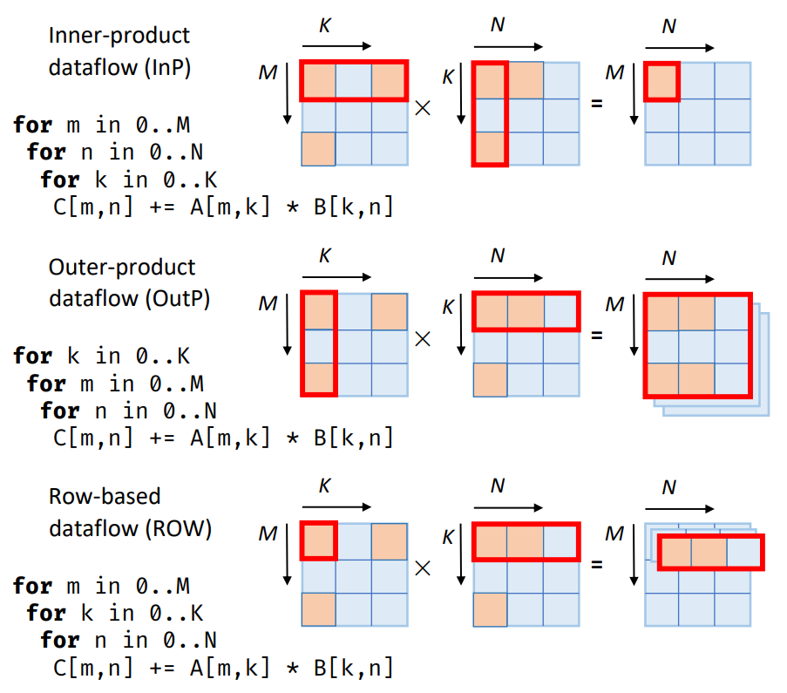
SpGEMM and sparse patterns
Different SpGEMM dataflows
 | InP | OutP | ROW
Input reuse | Poor | Excellent | Poor
Output reuse | Excellent | Poor | Good
Index intersection | Inefficient | Efficient | Efficient
Psum granularity | Scalar | Matrix | Vector
Different sparse patterns prefer
different dataflow schemes
Notes:
On the other hand, spGEMM has different execution dataflows. For example: inner product, outer product and row-based. In inner product dataflow, a row of Matrix A and a column of matrix B are dot producted to get a scalar element in the output. Then in outer product dataflow, a column of A and a row of B are cross producted to get a partial sum granularity. Last, in row-based dataflow, a scalar of A is multiplied with a row of B to produce a partial sum row. These dataflows have different performances in terms of data reuse, index intersection and partial sum granularity. Therefore, there is high performance improvement potential if adopting different dataflow schemes with respect to different sparse patterns.

Slide 26
Spada: Adaptive SpGEMM Accelerator
Adaptive hardware execution according to sparse patterns
Window-based dataflow
Easy to be adjusted
Cover wide tradeoff space
Mode-reconfigurable accelerator
Efficient to execute the window-based dataflow
Fast to switch among different modes
Profile-guided window shape
adaption algorithm
Effective to detect sparse patterns
Lightweight to track metrics
Notes:
To realize such potential, authors propose spada, which performs adaptive Hardware execution according to sparse patterns. First they propose an Adaptive window-based dataflow which is easy to be adjusted and covers wide trade-off space. Second, for the hardware, they propose a mode reconfigurable accelerator which is efficient to execute the dataflow and can switch among different modes. Last, they propose a profile-guided window shape adaption algorithm, which can effectively detect Sparse patterns.

Slide 27
Window-based adaptive dataflow
Adaptive hardware execution according to sparse patterns
Window-based dataflow
Easy to be adjusted
Cover wide tradeoff space
Mode-reconfigurable accelerator
Efficient to execute the window-based dataflow
Fast to switch among different modes
Profile-guided window shape
adaption algorithm
Effective to detect sparse patterns
Lightweight to track metrics
Notes:
First, we introduce the window-based dataflow.

Slide 28
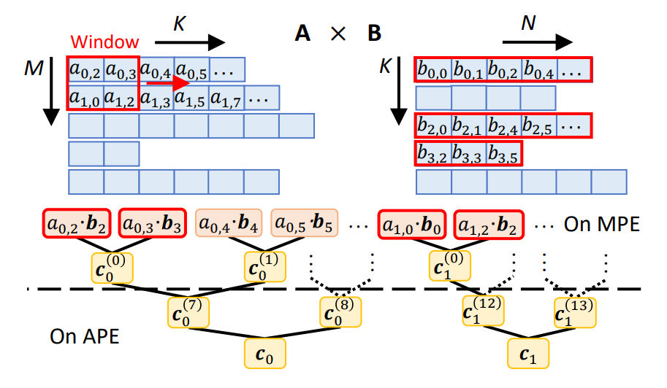
Window-based adaptive dataflow
Start from ROW-based
Scale to a window
Each pass the window is adjusted
Task trees:
Intra-window task: On MPE
Inter-window task: On APE
Notes:
Let’s start from the row-based dataflow. Row-based dataflow blockchain is decomposed as scalars from A multiplied by rows of B, and the window slides along the K Dimension. First, scale the scalar of A into a window. And we still slides the window in the K Dimension. Finishing an iteration of K, the window shape can be adjusted with respect to a fixed window. the whole SpGEMM computation forms many task trees with a scalar Vector multiplications as red nodes and reductions as yellow nodes. each task tree represents a computation for a single row in A matrix. we then divide those task trees intra and inter window tasks and place them onto heterogeneous units which improves the multiplier utilization.

Slide 29
Window-based adaptive dataflow
ROW
Height↓ Width↑
Window shape
Height × Width
Height↑ Width↓
OutP
Less psum produced √
Less matching indices ×
More psun produced ×
More matching indices √
Input reuse (B) ↓
Output reuse (C) ↑
Tasks:
Intra-window ↓
Inter-window ↑
Input reuse (B) ↑
Output reuse (C) ↓
Tasks:
Intra-window ↑
Inter-window ↓
Notes:
So we actually adjust the dataflow by changing the window shape. Less height and larger width means less psum and less matching indices. The input reuse of B is reduced while the output reuse of C is increased. The ratio of intra and inter window tasks is also adjusted. On the opposite, everything is reversed. We can trade off between them to find the best fit.

Slide 30
Mode-reconfigurable accelerator
Adaptive hardware execution according to sparse patterns
Window-based dataflow
Easy to be adjusted
Cover wide tradeoff space
Mode-reconfigurable accelerator
Efficient to execute the window-based dataflow
Fast to switch among different modes
Profile-guided window shape
adaption algorithm
Effective to detect sparse patterns
Lightweight to track metrics
Notes:
To support the window shaped dataflow, authors proposed mode reconfigurable accelerator.

Slide 31
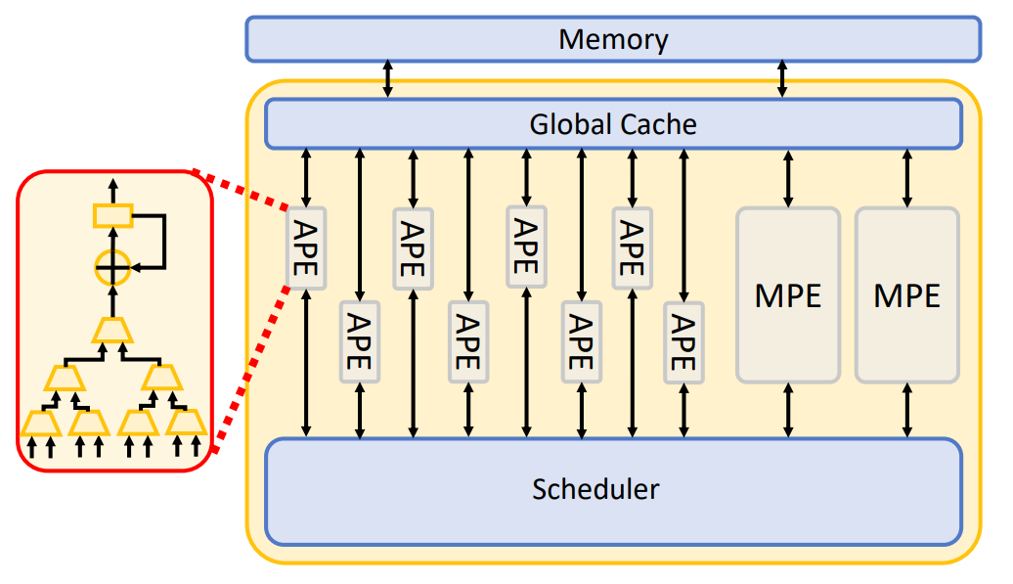
Mode-reconfigurable accelerator
Mutiplication Processing Element (MPE):
Intra-window task
Scalar-Vector multiplication
Addition Processing Element (APE):
Inter-window task
Partial sum (psum) intersection tree
Scheduler:
Arrange tasks
Track psums
Adjust window shapes
Global Cache:
Cache B rows and psums
Notes:
The accelerator is composed of MPE, APE, scheduler and Global cache. Their functions are list here.
Delete:
MPE processes intra-window tasks and scalar-vector multiplication. APE processes inter-window task and the partial sum intersection tree. Scheduler is designed for arrange tasks, track psums and adjust window shapes. Finally, the global cache is used to cache B rows and psums.

Slide 32
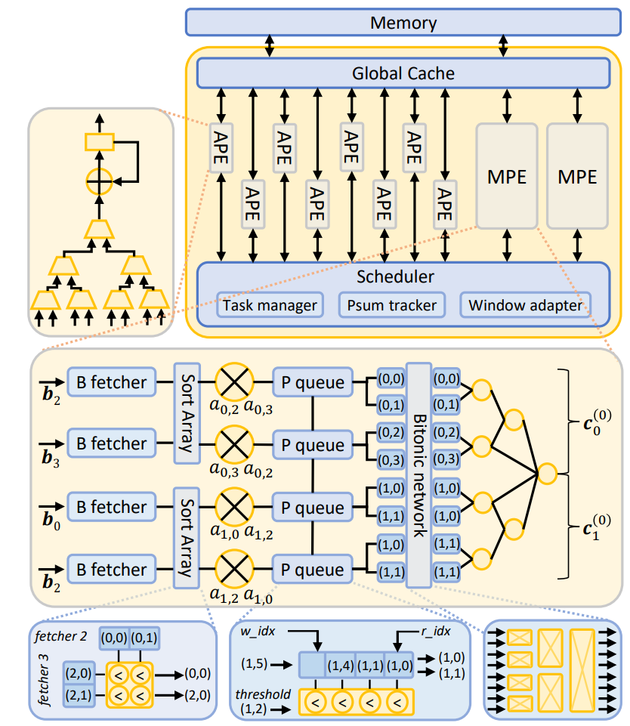
Mode-reconfigurable accelerator
Mutiplication Processing Element (MPE):
Intra-window task
Scalar-Vector multiplication
MPE mapping:
Num. of lanes == window size
Flexible grouping:
Modified Bitonic network
Flexible reduction tree
Notes:
Let’s look at the most important part, the MPE. MPE consists of multiple computation lanes to perform scalar vector multiplications, multiple bitonic networks and a flexible reduction tree which performs adaptable psum merges. To map the window, the number of lanes is equal to the window size. And each pair of scalar vector multiplication will be mapped into a lane. The bitonic network is to compute different parts of the task tree and output the separated products.

Slide 33
Mode-reconfigurable accelerator
MPE workflow:
Load A scalars to multiplier registers
B fetchers stream B rows
Load balance by Sort Array
Multiply A scalars with B elements
In-cycle ordering: Buffer products in P queue
Across cycle ordering: Sort products through Bitonic network
Merge products into psum in reduction tree
Notes:
The whole MPE works as the following.

Slide 34
Profile-guided window adaption algorithm
Adaptive hardware execution according to sparse patterns
Window-based dataflow
Easy to be adjusted
Cover wide tradeoff space
Mode-reconfigurable accelerator
Efficient to execute the window-based dataflow
Fast to switch among different modes
Profile-guided window shape
adaption algorithm
Effective to detect sparse patterns
Lightweight to track metrics
Notes:
Now we introduce the profile-guided window shape adaption algorithm.

Slide 35
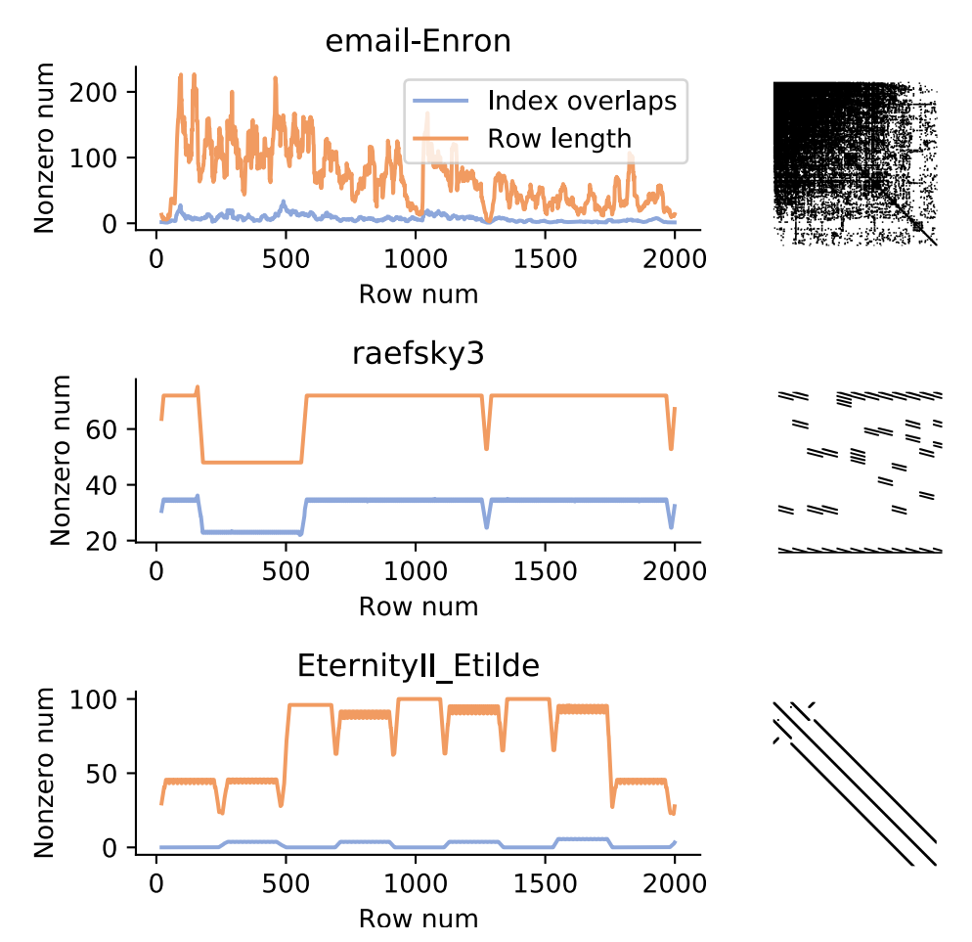
Profile-guided window adaption algorithm
Adopt to sparse patterns: Detect sparse patterns + Adjust window shapes
Detect:
Hard to track sparse patterns …
But easy to detect sparse pattern changes.
Indicate sparse pattern changes by row length variations
Notes:
We need to adjust the window shapes according to sparse patterns. However, it’s hard to track the sparse patterns. Instead, it’s easy to detect sparse pattern changes by row length variations in the CSR sparse matrix format.

Slide 36
Profile-guided window adaption algorithm
Adopt to sparse patterns: Detect sparse patterns + Adjust window shapes
Adjust:
Patition A rows into bands by changes in sparse pattern
For a large band:
Each window shape is profiled
Select the best kernel for the rest in the band
For a small band:
Contiguously adjust the window shape
in a cost-descent way
Notes:
Then to adjust to the row length, we need to partition A rows into bands by changes in sparse pattern. Different sizes of bands means different strategies.

Slide 37
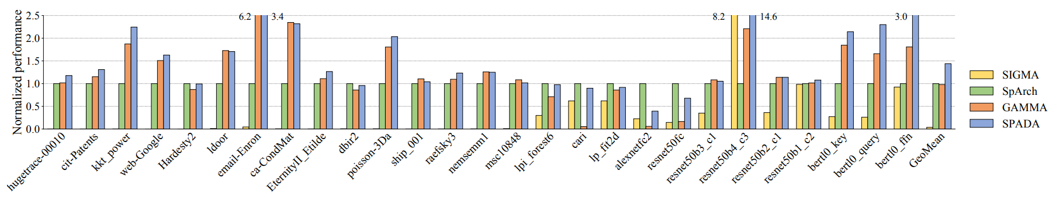
Performance
Performance comparison among SIGMA, SpArch, GAMMA, and Spada: 3.32x and 1.42x
Notes:
In evaluation, authors compare Spada with 3 SOTA accelerators in a fair setting. From the exp results, Spada is on average 38x, 1.44x, 1.46x faster than sigma, sparch, gamma; performance on same area: 3.32x and 1.42x faster than sparch and gamma.

Slide 38
Summary
Identify the impact of sparse patterns on SpGEMM performance
Spada, a hardware-software co-design
A window-based adaptive dataflow
A mode-reconfigurable accelerator
A profile-guided window shape adaption algorithm
On average 1.44x speedups
Notes:
In summary, the paper indentifies the impact of sparse patterns on spGEMM performance. Authors proposed Spada, a hardware-software co-design to accelerate spGEMM, achieving an overall 1.44x speedups.

Slide 39
PART.04
EVStore: Storage and Caching Capabilities for Scaling Embedded Tables in Deep Recommendation Systems
Daniar H. Kurniawan, Ruipu Wang, Kahfi S. Zulkifli, Fandi A. Wiranata,
John Bent, Ymir Vigfusson, Haryadi S. Gunawi
University of Chicago, Beijing University of Technology,
SeagateTechnology, Emory University
Notes:
- Now we have talked enough about sparse matrix calculations, but on the other hand sparse matrix storage is an equally challenging problem. Just think of the sheer volume of bits necessary to store all the 0s!
- And that’s why I am going to introduce a research paper that I read, called “EVStore: Storage and Caching Capabilities for Scaling Embedded Tables in Deep Recommendation Systems“, which introduces a novel caching structure and look-up algorithm that improves efficiency in storing sparse structures in deep recommendation systems.

Slide 40


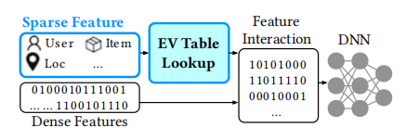
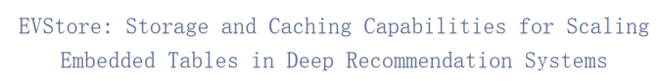
Background
Recommendation Systems
Categorical Input Features
Embedding Vector Tables
Recommendation systems are prevalent in helping people make decisions across modern online platforms.
Categorical input features, namely, store data concerning user preferences in multiple categories
Embedding table vectors, which are dense vector representations of categorical or discrete features, are often used to represent categorical variables.
Notes:
- Most online platforms nowadays use deep recommendation systems to personalize user experience, they display personalized advertisements, rank news and recommend products based on user behavior and preferences. 60% of all videos on Youtube come from suggestions made by recommendation systems, this picture is a realistic comment on the fact that recommended videos would look very different on the home page of differerent users.
- Within a deep recommendation system, how to tackle categorical input features is the main challenge. Since the categorical input features in modern recommendation systems usually contain massive numbers of categories, but only a few categories are present in a particular observation, resulting in a high-dimensional feature space with mostly zero values.
- Therefore categorical input features are usually considered sparse features, and the sparsity of categorical input features can pose challenges in machine learning models or more explicitly, deep recommendation systems (DRS).
- Through using dense vectors to represent categorical variables and generalizing their representation by capturing their underlying semantic relationship, embedding table vectors allows the deep learning model to store data and compute more efficiently, thereby reducing the dimensionality and alleviating the sparsity problem.
- However, as users become more reliant on these systems, they expect higher quality recommendations that are tailored to their individual preferences. To meet this demand, recommendation systems must be able to encode richer semantic relationships, which requires larger EV tables. This has led to a tripling of EV table sizes every two years, which is even faster than the speed of the number of transisters on a microchip multiplies as stated by the moore’s law.
- Unfortunately, the state-of-the-art DRSs are simply not equipped to handle the exponential growth of EV table sizes. To address this problem, this paper works on improvement in the DRS itself, more explicitly it adds a novel caching layer within the DRS platform that is optimized especially for EV access patterns --- EVStore.

Slide 41
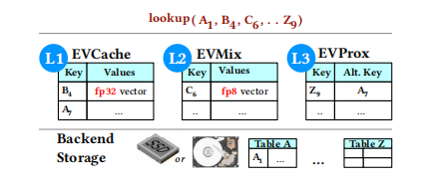
EVStore’s main contributions
EVStore’s 3-layer “L1-to-L3” caching design according to sparse patterns (EVCache, EVMix, and EVProx):
L1: EVCache
L2: EVMix
L3: EVProx
A Caching Layer that stores EV tables as key-values in the DRS memory
Delegate some space from L1 into L2 to store relatively lower precision embedding values. The combination of L1 and L2 are called EVMix, which stands for mixed-precision caching.
A key-to-key caching layer that maps each key to a surrogate key with a similar embedding value which is preferably more likely to reside in the L1/L2 cache to alleviate accesses to the backend storgae.
Notes:
- EVCache is a caching layer where EV tables are stored as key-values in the DRS memory and backend storage.
- To accommodate diverse latency and accuracy tradeoffs, EVStore delegates some space from the L1 into an “L2” segment that stores lower precision embedding values. For instance, whereas the first layer stores 32-bit floating point values (fp32), the second layer can store lower precisions (e.g., in 16, 8, or 4 bits). This form of mixed-precision caching brings several advantages: allowing more key-value pairs to be cached, increasing hit rates, accelerating inferences, and boosting throughput in trade for a minor loss of accuracy.
- Finally, EVStore leverages another unique characteristic of embedding values: The value for a key that is not in the cache can be replaced by a surrogate key whose value is “approximately similar” to the original key’s value. And that’s exactly what L3 does. EVProx is a key-to-key caching layer that maps each key to a surrogate key with a similar embedding value that is likely to reside in the L1/L2 cache. This design achieves similar results in categorical input features processing but help alleviate accesses to the backend storage, thereby reducing search time and boosting efficiency.

Slide 42
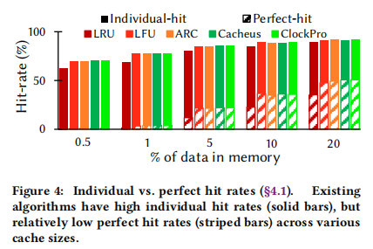
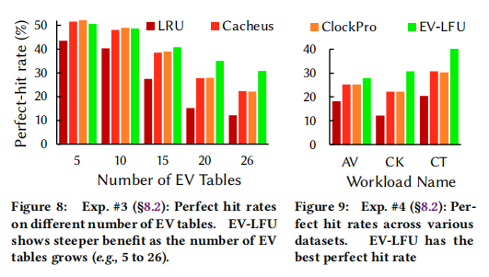
Significance: Increase Perfect Hit-rate
The EV-LFU algorithm improve upon state-of-the-art algorithms by increasing the perfect hit rates by up to 18%, lending support to the need for groupability for EV-based caches.
In contrast, EV-LFU increases the perfect hit rate while sacrificing the individual hit rate for each of the tables (which is acceptable since the perfect hit rate is more significant for DRS). And the result applies for a reasonable number of EV Tables and various datasets.
Notes:
- To measure the performance of EVStore compared to state of the art cache replacement algorithms, two commonly used metrics to quantify caching performance are used in this paper. the individual hit rate and the perfect hit rate.
- The individual hit rate measures the ratio of successful key-value lookups in the cache out of all the lookup operations.
- The perfect hit rate, on the other hand, measures the ratio of a series of keys from a single inference request being successfully found in the cache. The perfect hit rate is a stricter metric than the individual hit rate.
- Since an inference in the DRS will query a set of keys to all of the EV tables, hence a cache miss on just one of the keys will make the entire inference slow. Therefore the perfect hit rate is more crucial in measuring DRS performance than individual hit rate.
- See the left chart, existing algorithms have high individual hit rates (solid bars), but relatively low perfect hit rates (striped bars) across various cache sizes.
- As is shown in the graph on the right side, the EV-LFU algorithm proposed by this paper improve upon state-of-the-art algorithms by increasing the perfect hit rates by up to 18%. Although EV-LFU algorithm sacrifices the individual hit rate for each of the tables, it is acceptable since the perfect hit rate is more significant for DRS. And the result applies for a reasonable number of EV Tables and various datasets.
- In conclusion, the EVStore paper presents a three-layer caching design to alleviate access to backend storage and a lookup algorithm to increase the perfect hit-rate. The design and algorithm work together to reduce search-time and boost efficiency in deep recommendation systems.

Slide 43
That's all for our team's report
Thanks for Watching
参与同学：杨沛山、张天杰
周炜、陈苇远
秦雨扬、刘晋玮
Notes:
In a nutshell, our group introduces three papers from ASPLOS 2022 and 2023, all of which tackles challenges caused by sparse structures, accelerating machine learning models by hardware-software approach. That's all for our team's report, thanks for watching!

